Slide 1
If you believe travel planning should feel like texting your best friend - this is exactly the product that bridges that gap.

Slide 2
APP FEATURES
Flight Search (Based on location, date, budget)
Hotel Recommendations (Location-based with filters)
Smart Travel Suggestions (Best places to visit by season/time)
Multi-turn Conversations (Natural human-like chat flow)
Travel FAQs (Visa, COVID rules, budget tips, etc.)
Lightweight UI for Easy User Experience
DEVELOPMENT OF THE APP
Backend Development
Built using RASA Framework (Open-source conversational AI)
RASA Core: Dialog Management
RASA NLU: Intent & Entity Extraction
Custom Actions for Flight/Hotel Search & Recommendations API Integration Ready
Frontend Development
Built using Flutter (Cross-platform Framework)
Clean Chat UI mimicking WhatsApp-like Experience
Android Studio for Emulation & Testing
REST API Integration with RASA Backend

Slide 3
RASA FRAMEWORK
Why RASA?
Open-source & Flexible
Easily Trainable Custom Models
Multi-turn Context Handling
Two main components:
Rasa NLU - Understands user input (intents & entities)
Rasa Core - Manages conversation flow
Fully customizable with Python-based logic
Supports integrations with messaging platforms (Telegram, Slack, etc.)
Implementation
Intents
Entities
Stories & Rules for Dialog Flow
Custom Actions to Fetch & Reply with Travel Info
Deployed RASA Backend for API Access

Slide 4
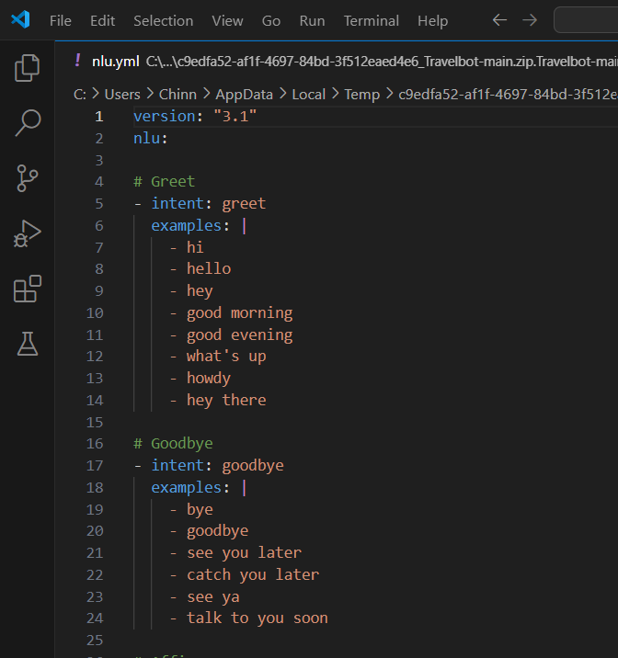
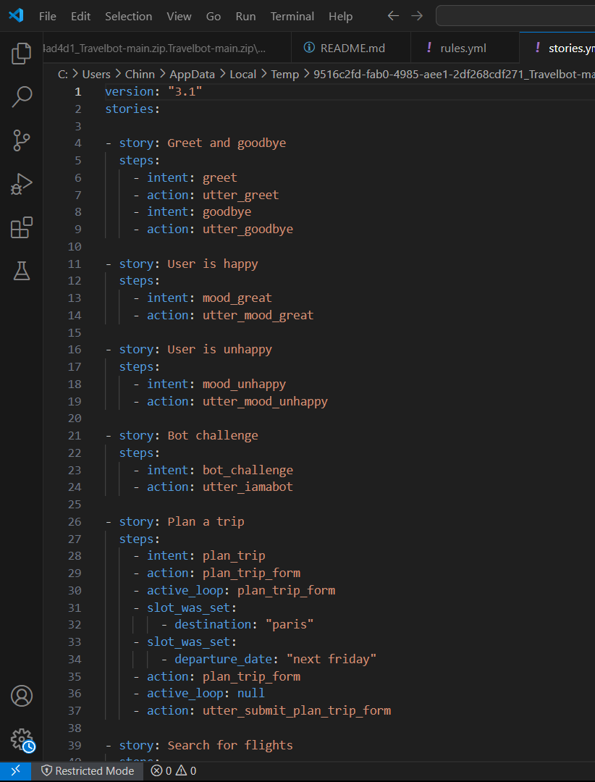
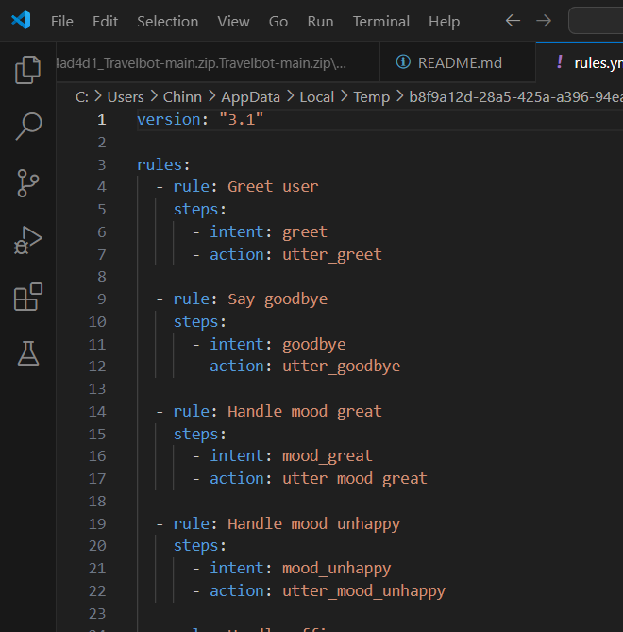
Key Files in Rasa Project Structure
nlu.yml
User examples and intents for NLU training
Contains user messages labeled with intents
Helps the bot understand what the user wants
Can include entities (e.g., names, locations, dates)
stories.yml
Sample conversations to guide dialogue flow
Step-by-step dialogue examples
Trains the bot on how to respond across multiple turns
Uses: intent → action mapping
rules.yml
Fixed rules for predictable responses
Rule-Based Responses
Hardcoded rules for consistent behavior
Good for FAQs and fallback handling

Slide 5
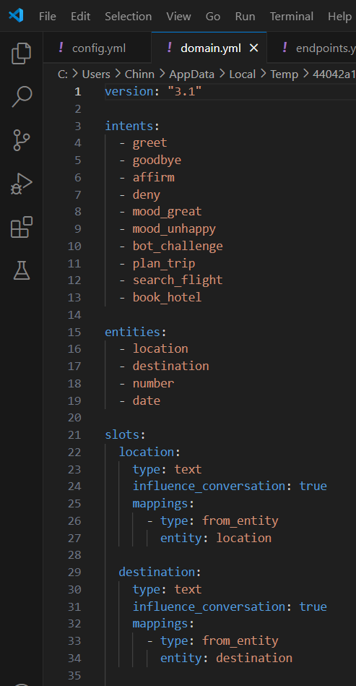
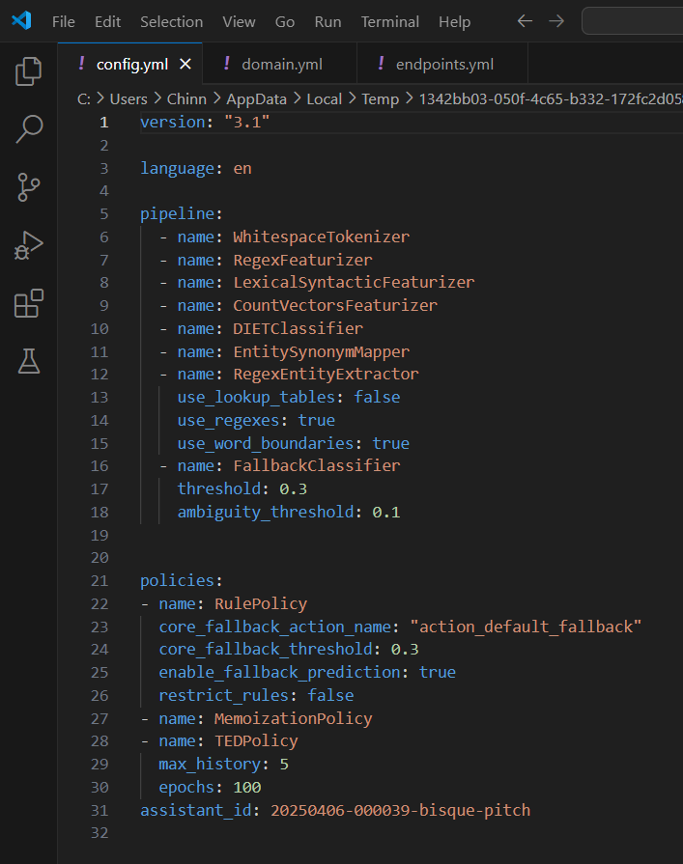
Bot Configuration Files
domain.yml
It defines intents, entities, slots, actions, and responses.
- Bot Blueprint
Central config file connecting all components
Defines:
intents: What users might say
entities: Key values extracted from messages
slots: Memory to store info during chat
responses: Bot replies
actions: Custom actions
config.yml
NLU pipeline and dialogue policies setup
- Training Pipeline & Policies
Sets up the NLU pipeline (tokenizer, intent/entity models)
Defines conversation behaviour using policies:
MemoizationPolicy: Uses memorized stories
RulePolicy: For handling rules
TEDPolicy: ML-based decision making

Slide 6
About Flutter Framework and Android Studio
Flutter is a powerful open-source framework for building cross-platform mobile apps using a single Dart codebase. While alternatives like React Native, Xamarin, and Kotlin Multiplatform exist, Flutter stands out for its
native performance
rich UI library and
excellent developer experience - making it a great fit for custom chatbot apps.
Android Studio, developed by Google, is the official IDE for Android development. Although other editors like VS Code are lightweight and flexible, Android Studio provides full-featured tools for:
UI building
Emulation
Debugging and
performance tuning - especially for apps using Flutter.
Why We Chose Flutter for the Chatbot Frontend
Cross-platform framework – Runs on Android, iOS, web, and desktop with one codebase
Single codebase – Faster development, fewer bugs, and easier maintenance
Rich widget system – Ideal for building custom, responsive chatbot UIs
Hot Reload – Allows instant updates while coding, speeding up the development cycle
Native performance – Provides smooth animations and responsiveness

Slide 7
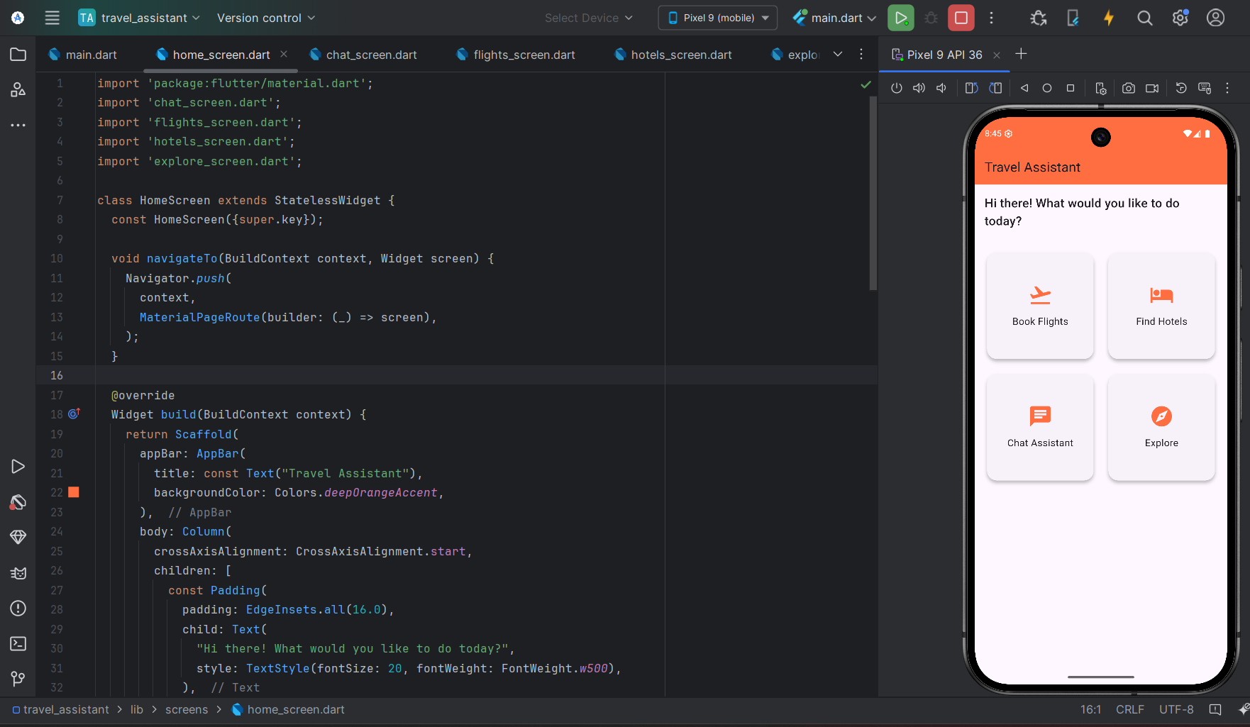

Slide 8
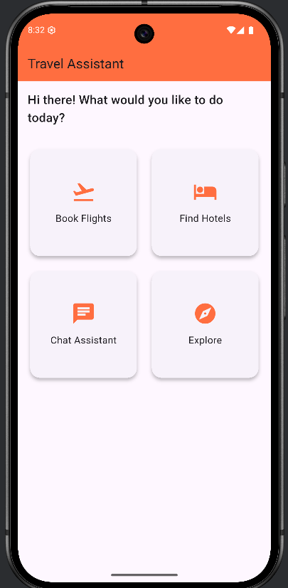
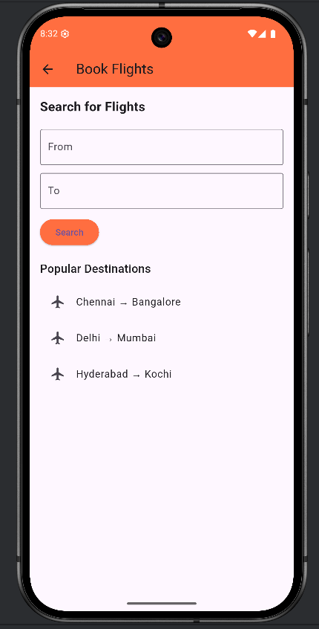
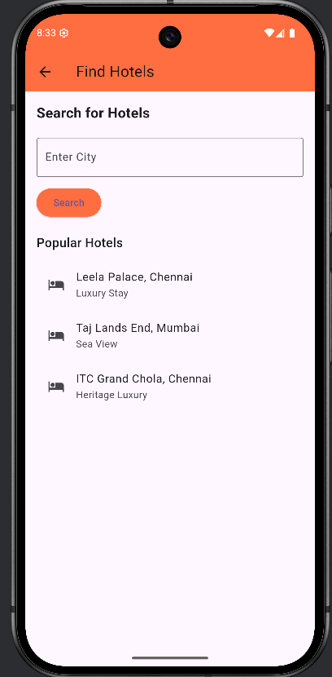

Slide 9
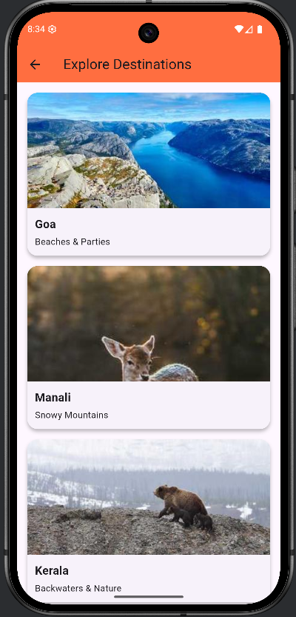
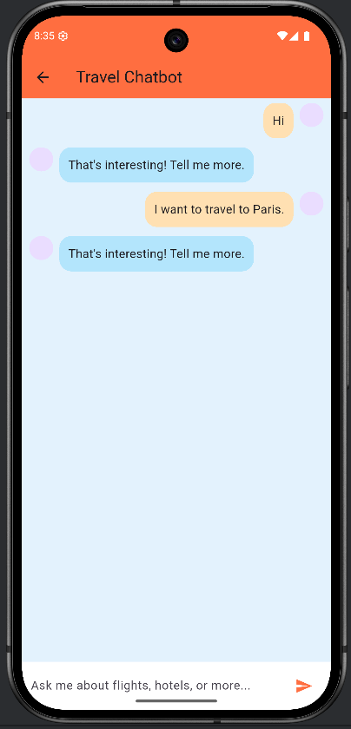

Slide 10
Problem Statement: Planning travel today is often messy, confusing, and time-consuming - especially for people unfamiliar with digital platforms. Searching for flights, comparing hotels, understanding local travel rules, or even deciding where to go requires jumping between multiple apps & websites.
Where It Can Be Applied:
Personal Travel Planning (individuals, families, students)
Small Travel Agencies (as a customer assistant bot)
Hotel/Flight Booking Platforms (integrated as service bot)
Rural/Remote regions with lower tech exposure
Quick Travel Queries at Airports / Hotels / Tourist Helpdesks
Target Audience (Who Can Use or Buy This)
Frequent Travelers looking for quick trip planning.
Students planning vacations on a budget.
Elderly people struggling with complex travel websites.
Small Travel Agencies wanting to automate customer queries.
Remote workers, backpackers, solo travelers looking for easy suggestions.
Busy Professionals who want ready travel options without effort.
Mobile App Developers or Businesses wanting to embed a smart chatbot.

Slide 11
User-Centric Statistics (Impact & Accessibility)
65% of travel bookings today start from mobile phones.
70% of users feel overwhelmed searching across multiple travel sites.
55% of users abandon booking midway due to complexity.
NLP based Chatbots reduce customer effort by up to 40%.
80% of non-technical users prefer chat-based solutions over forms.
How It Benefits Diverse Users:
For Non-Technical Users: No complex filters - users can chat naturally or choose from predefined search options for faster results. Designed to feel like chatting with a friend - ensuring a smooth and friendly experience for users of any age.
For Unemployed or Budget Travelers: Helps them discover low-cost travel options easily. Provides tips on budget stays, offers & travel hacks.
For Remote/Rural Population: Easy to use on basic smartphones. No technical knowledge required. Can be available in local languages for future expansion.

Slide 12
THANK YOU

